Slide 2
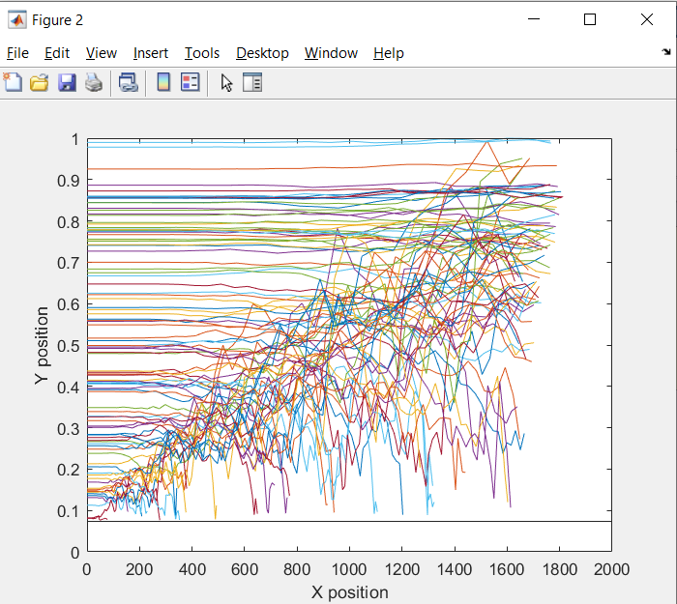
Strange observations
Why does it take a while for diffusion to set in?
Why do the ones that go below disappear?

Slide 3
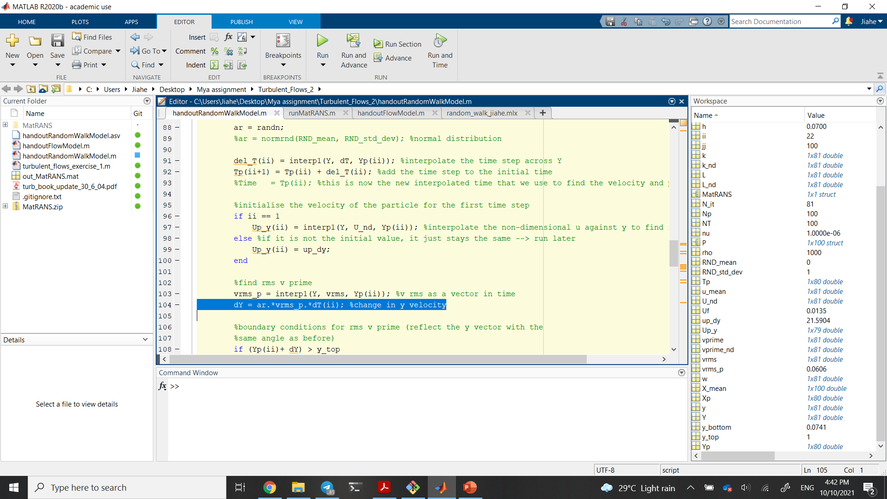
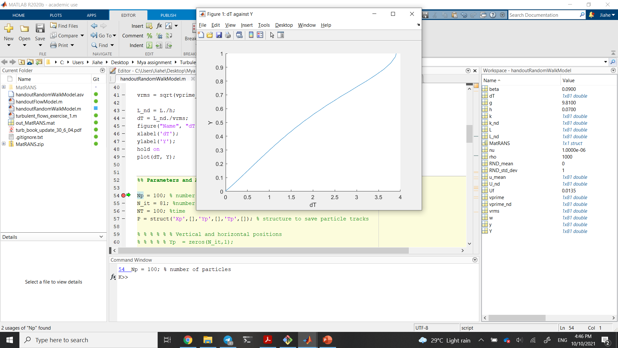
1) Late onset of dispersion
dT is a function of Y, not time

Slide 4
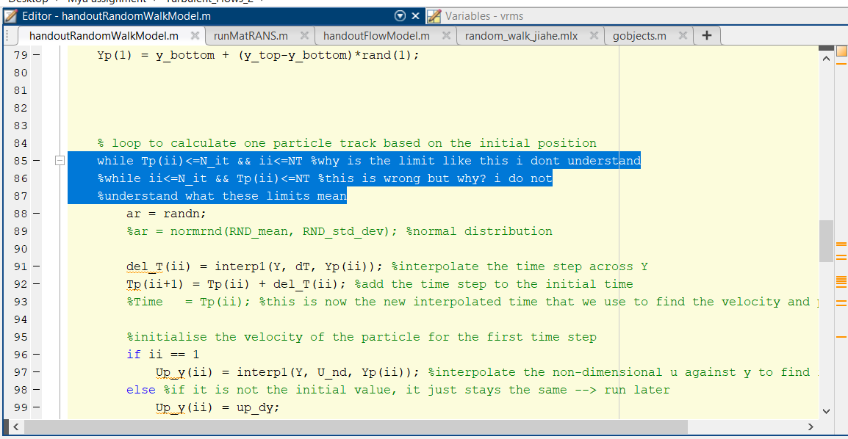
Side note
Tp is a time; ii is an iterator, therefore T should be compared to NT (also a time) and ii to N_it (number of iterations
The second line is “Wrong” because of a number of coincidences, but the main offender is the error on the previous slide. It is in fact the CORRECT statement
Learning point: Code is meant to help you; you need to understand what you’re doing, not let errors, syntax and whatever hoops you need to jump through to get your code “Working” sway your judgement

Slide 5
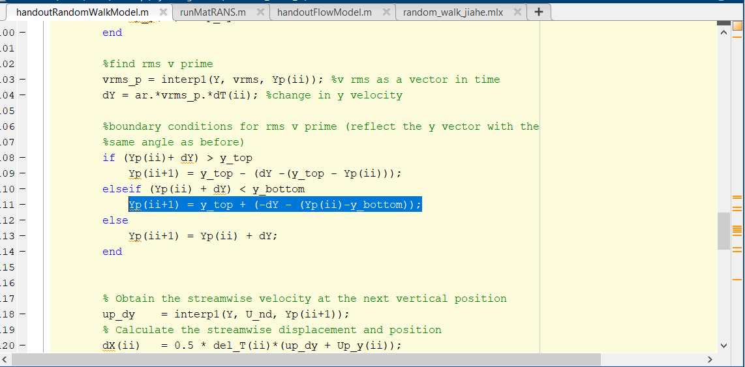
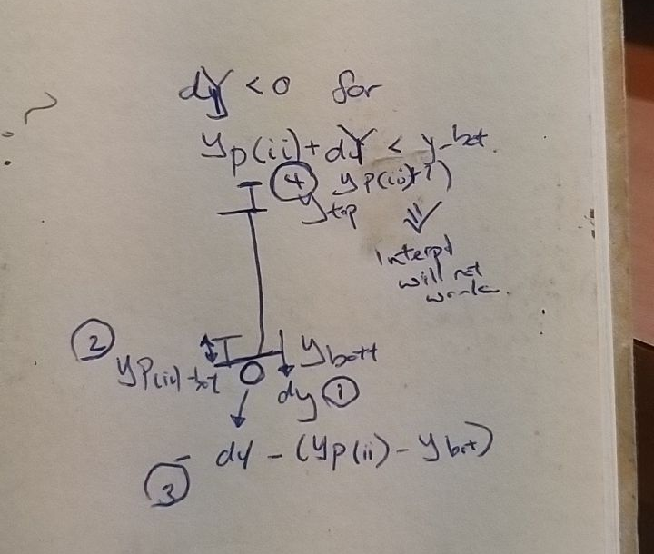
2) Disappearing tracks

Slide 6
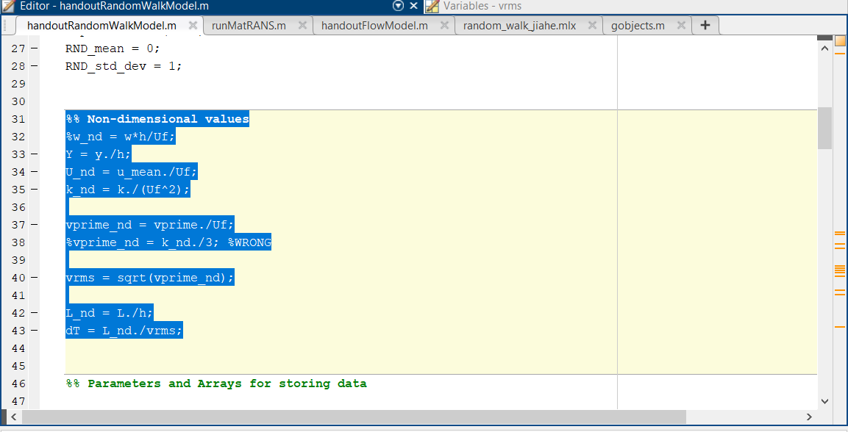
A note on consistency
Does _nd denote non-dimensionality? Or a Capital Letter? Or both? What about vrms?
I don’t think there were any problems that resulted from it, but it is confusing.
Side note, was there a need to non-dimensionalize k?

Slide 7
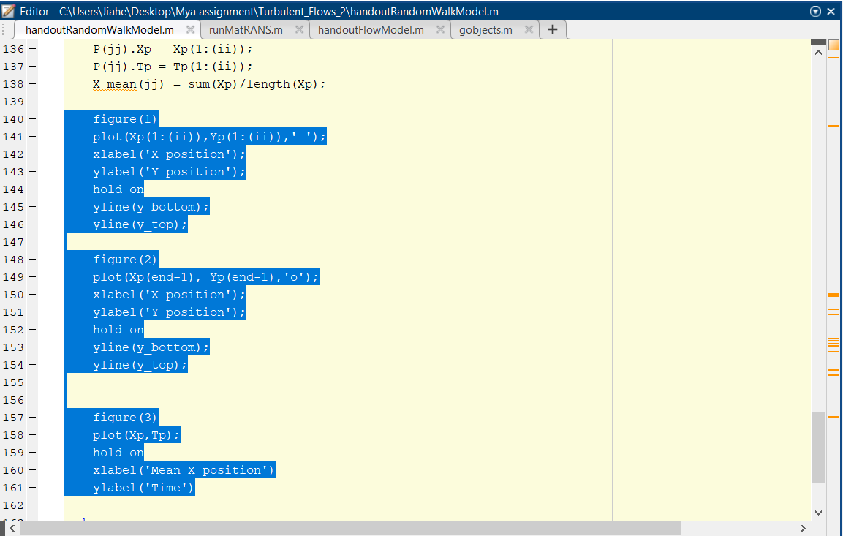
A note on plotting
There is no need to set the label every loop, or draw the bottom and top lines every loop
All you need to do is set a reference to the figure, and set it as the active figure before plotting.
Its a lot faster that way.
Random note: Xp Yp (end-1) will give you the longest trial because you never reset the length of Xp & Yp. This means a lot of particles end up in the wrong place in the plot

Slide 8
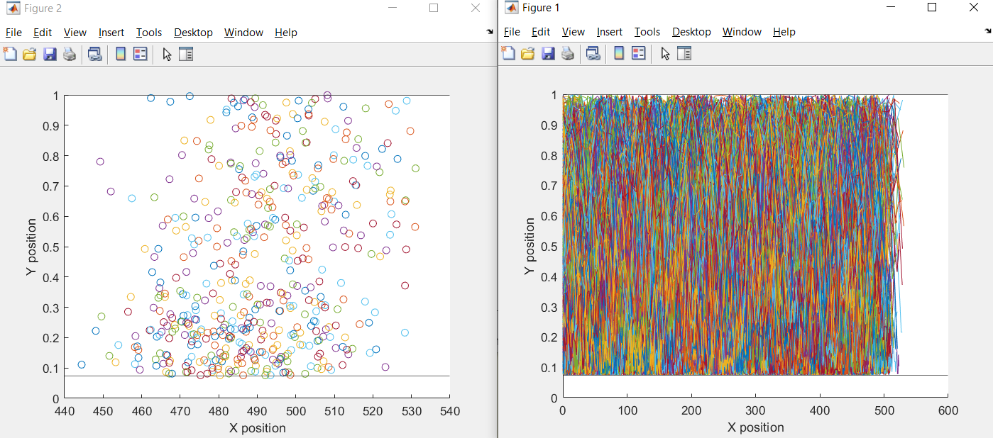
After fixing the changes
A quick note: It might look really messy, but you must note the length scale: X is 600 times the scale of Y, its not surprising that the particle will be able to travel 1 Y what looks like a short distance in X

Slide 9
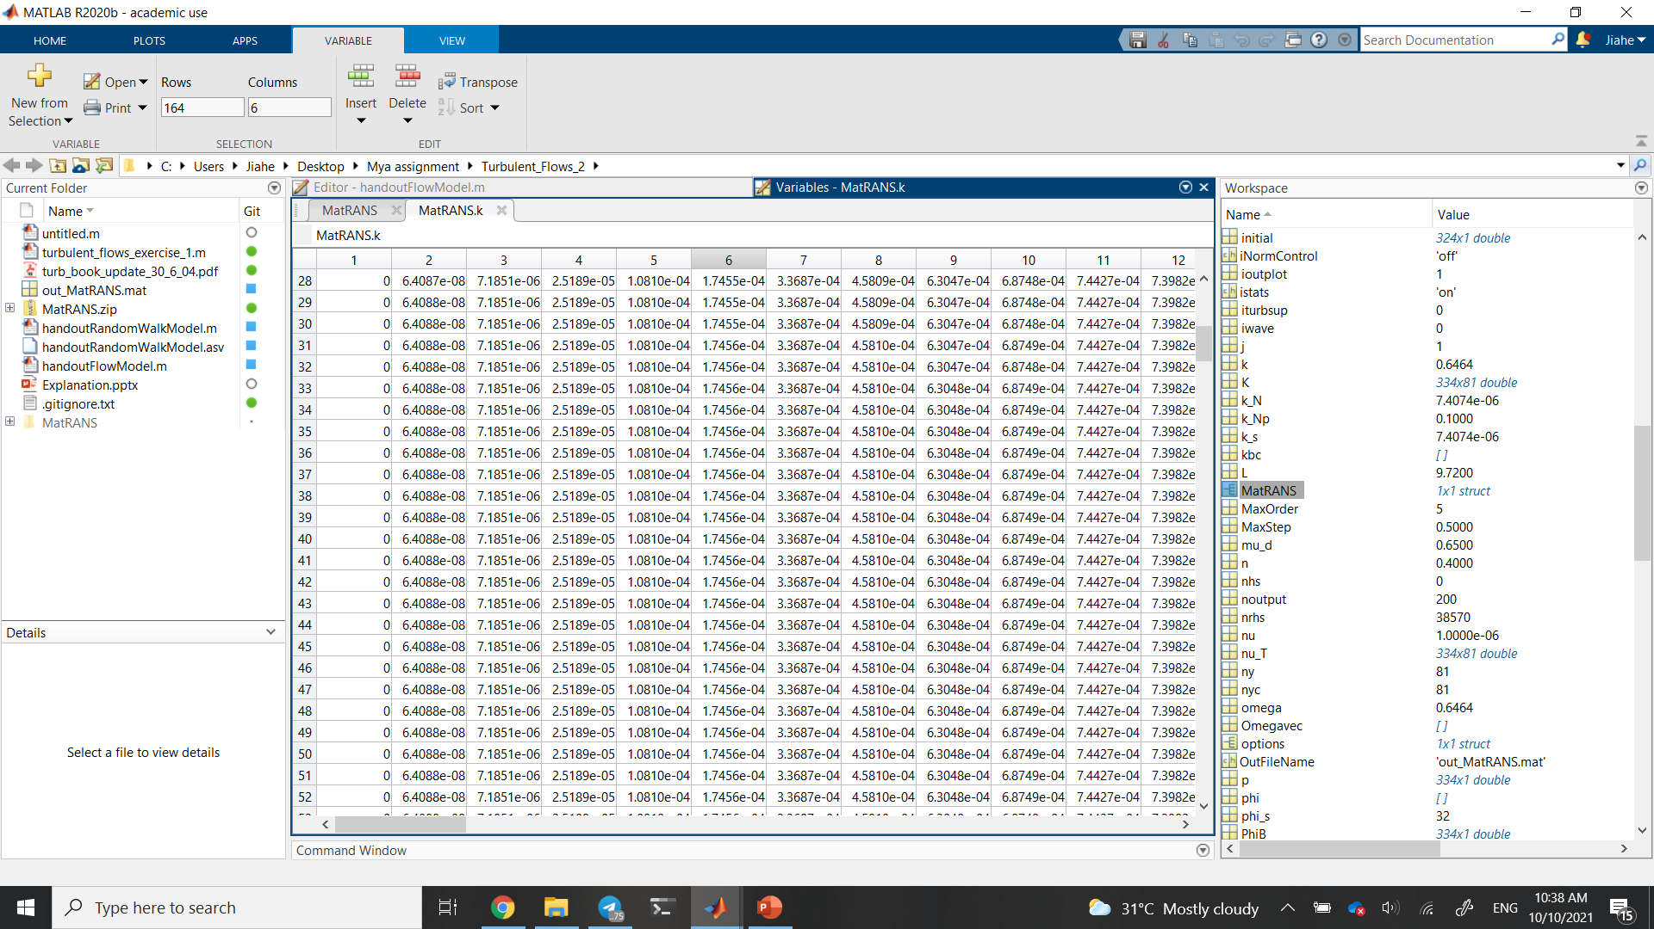
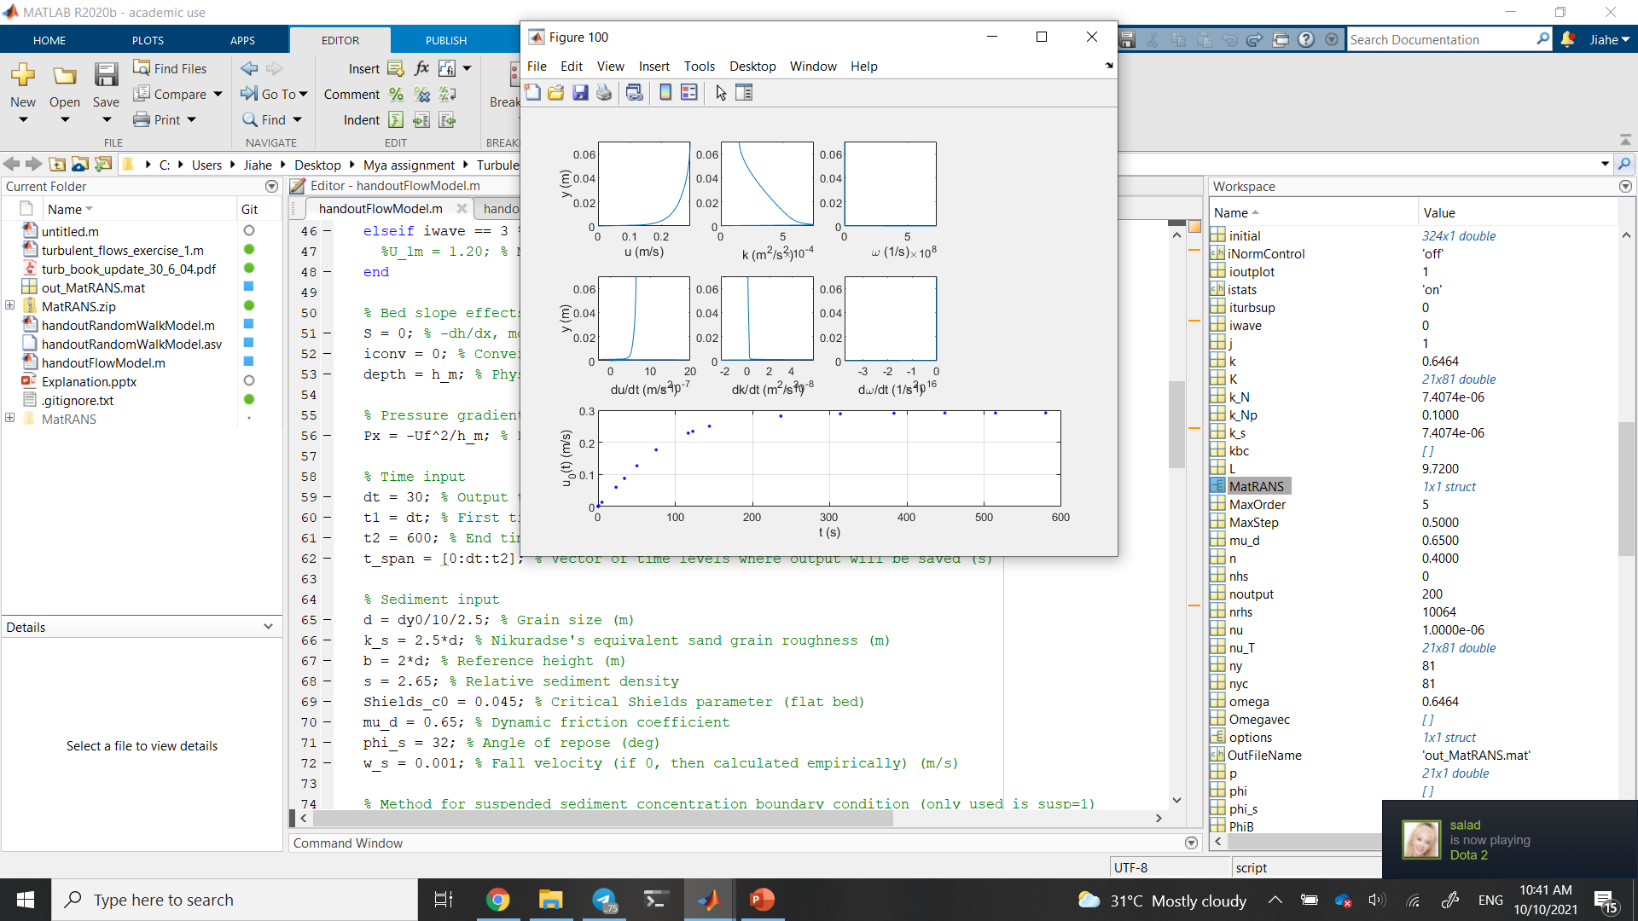
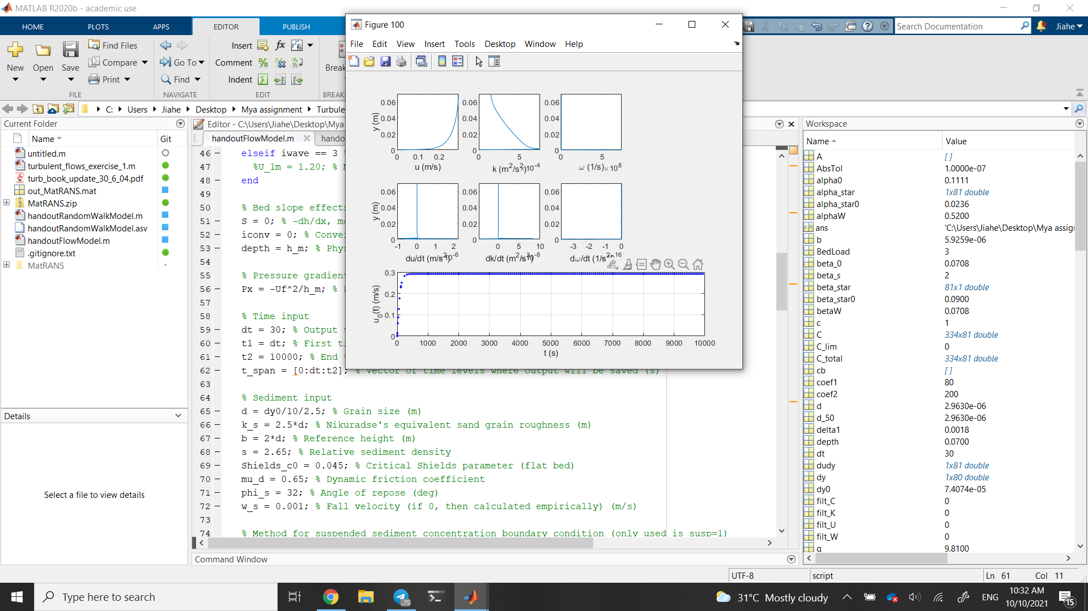
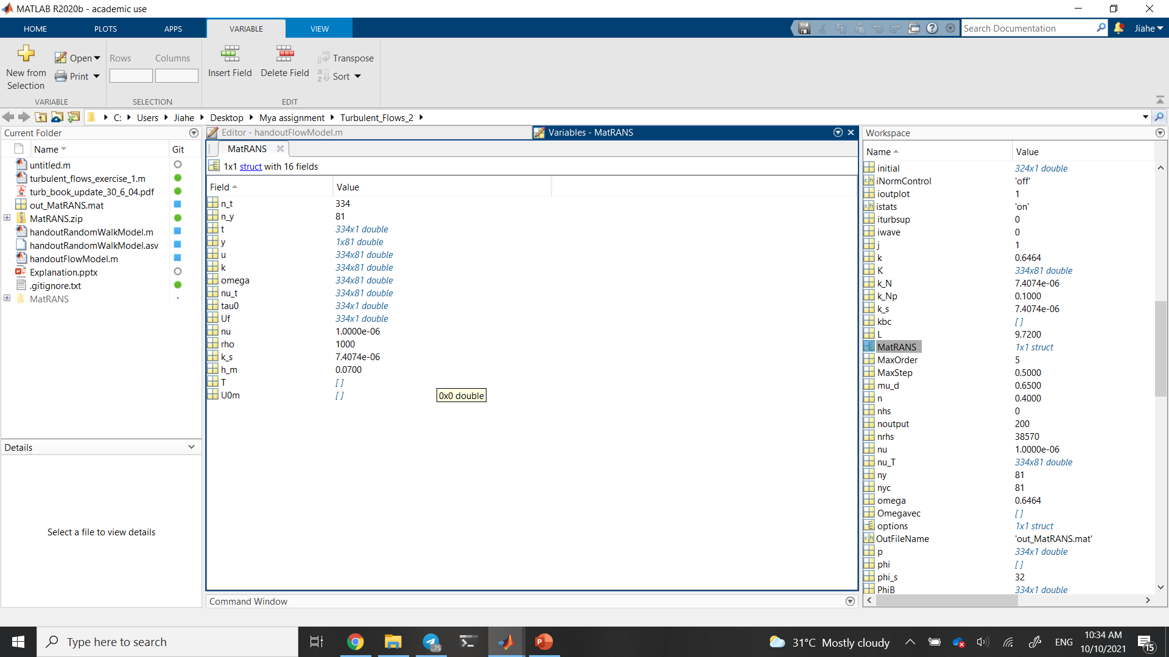
Why take the last row of values?
Rows represent a single point in time, columns represent different heights.
Values become constant past a certain time
This time happens well within the end time of the original simulation

Slide 10
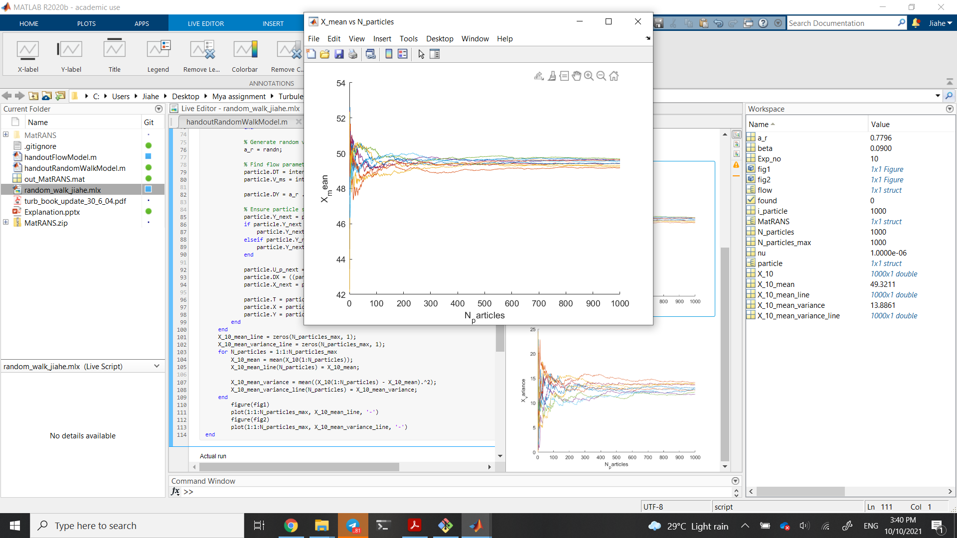
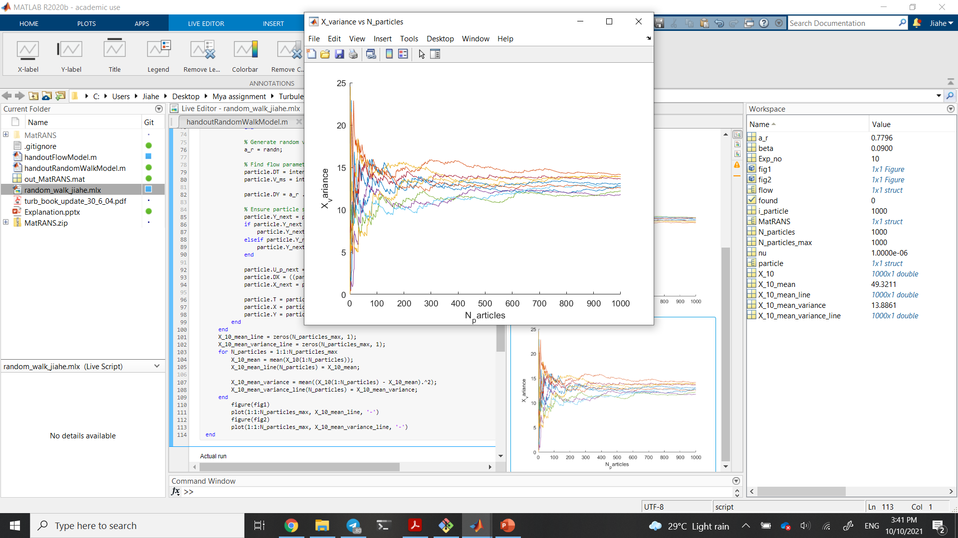
Determination of N_particles

